Slide 1

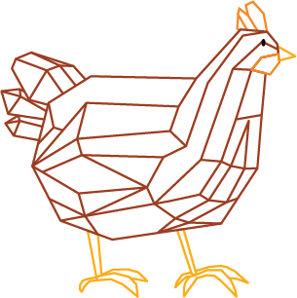

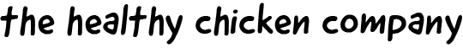
Knowledgebase Presentation

Slide 2
Areas of Interest
4
1
Changes of broiler behaviours through their life
4 main behaviour categories
2
5
Comfort vs flight behaviours
4 Conditions
3
6
Construction and operations of the shed
Future plans and challenges

Slide 3
Broad Categories of Behaviours
1
3
Locomotion and foraging behaviour
Lying and resting behaviours
2
4
Feeding and drinking behaviours
Grooming and dustbathing

Slide 4

Behaviour
Action
Locomotion and foraging behaviour
Pecking, scratching ground - behaviours that simulate looking for food in the wild
Wing flapping, leg movements, pacing
Feeding and drinking behaviours
Eating and drinking from feeders and drinkers
Lying and resting behaviours
Staying still, sitting and sleeping with head on the floor
Grooming and dustbathing
Preening and scratching combined ie cleaning behaviours to get rid of dust in features

Slide 5
Locomotive Behaviours
Factors that increase frequency
Can be linked to both positive and negative behaviour as there is a lot of commonality between foraging behaviours
Head movements is a type of locomotive behaviour as it
Lack of locomotive behaviours cause lameness (lameness can be counteract this)
Lighting - encourages more activity
Factors that increase frequency | Factors that decrease frequency
Lighting | Age
Slow growing broilers | Darkness
Density
Environmental enrichment
Factors that decrease frequency
Slower growing broilers display more locomotive behaviours
Density increases as flock influences behaviours
As the bids get older they reduce activity
Environmental enrichment increases this
Notes:
Positive negative as can be a comfort behaviour but also a calming down technique
Locomotive behaviours can lead to more activity and healthy birds

Slide 6
Foraging Behaviours
Examples: Pecking, scratching ground - behaviours that simulate looking for food in the wild
Foraging behaviour should occupy about 60% of their day time (naturally occurs in the wild for jungle fowl) - this shows that the natural state / comfort behaviour can be inferred through time spent foraging
Closely tied with locomotive behaviors to move around the shed
Head movements or time spent foraging can reflect insatisfaction with diet
Can be encouraged by enriching environment through
Will display foraging behaviours in artificial environment by pecking at objects (Pecking stones)
Closely tied with locomotive behaviors to move around the shed
Head movements or time spent foraging can reflect insatisfaction with diet
Can be encouraged by enriching environment through
Will display foraging behaviours in artificial environment by pecking at objects (Pecking stones)
60% of their time

Slide 7
Feeding and Drinking Behaviours
These are behaviours are not tied to foraging behaviours as they can have food whenever they want
Most feeding behaviours happen during the day, however, they are very susceptible to other birds behaviours (natural flock behaviour)
Factors that affect the feeding and drinking behaviours - breed, age of birds, particle size, diet and lighting
Lighting schedules can be used to manipulate the feeding cycles of the birds
In full light and full dark they feed consistently but same volume as photoperiodic routines
Drinking follows similar patterns but bigger risk due to contaminants
Lack of hydration will cause reduced mobility and skin lesions as a result of having to compete for water
Influencing factors
These are behaviours are not tied to foraging behaviours as they can have food whenever they want
Increased by density as other birds behaviours influence each other
Lighting schedules can be used to manipulate the feeding cycles of the birds
In full light and full dark they feed consistently but same volume as photoperiodic routines
Drinking follows similar patterns but bigger risk due to contaminants - checked twice a week
Lack of hydration will cause reduced mobility and skin lesions as a result of having to compete for water
Lighting - manipulates frequency but not quantity
Breed - variety of daily quantity and schedule
Density - birds influence each other and crowd around drinkers
Age - feeders filled more as birds grow more
Notes:
Mostly similar in brooding birds
Quantity of food consumed increases as the bird - most change is seen in the brooding period
- more specifically at the start or end of the day - depending on their ability to predict the onset of darkness as seen by studies that have proven peck count is increased is neighbours pecking is increased
Essential amino acids added to feed to make it cleaner - The essential amino acids are methionine (+cystine), lysine, threonine, valine, isoleucine, leucine, tryptophan, arginine, histidine and phenylalanine (+tyrosine)
Mostly composed of cereals grains, their products and by-products; oilseeds, oil fruits, their products and by-products, tubers, roots, their products and byproducts; other seeds and fruits, their products and by-products; milk products and fish, other marine animals, their products and by-products.

Slide 8
Lying and Resting Behaviours
Highly influenced by synchronicity to not disturb other birds, so very susceptible to light
As they grow older they sleep a lot more - quarter of time at end of life
Largely influenced by lighting times as it effects synchronicity
Resting along walls to reduced probability of a disturbance
Differs from sitting as its head is resting on the ground
Largely increases as birds grow older, especially increased after day 6 of the flock. By the time they are 5-6 weeks old they spend at least a quarter of their time asleep.
Largely increased by the influence of other birds in the shed and lighting - when in light for 23hrs they often lose their synchrony and far less sleep as more disturbances
Easily confused with huddling/clustering behaviours as they can rest closer to each other
Largely influenced by lighting timings and group synchronization.
Like resting along walls due to reduced probability of a disturbance

Slide 9
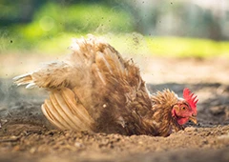
Grooming and Dustbathing
Most dust in sheds originate from the litter that has dried then becomes airborne
Based on frequency to determine if it is comfort or stress behaviour
Increased in lower density as they have more space
Most preening common before sleeping
Dust bathing Good indicator of welfare and maintains feather appearance
Notes:
15% of day time and 12% of night time in gulls
Inability to effectively dust bath will cause frustration and poor feather conditions
Preening increases in a period of reward anticipation so shows that it is an indicator of arousal
2 phases to the dustbathing, ‘tossing’ and then rubbing. It is key whatever they are bathing in penetrates the feathers of the birds
is the process of the birds rolling around in dust as away of cleaning themselves and getting rid of lipids. Most time spend in bedding with wood shavings.

Slide 10
Comfort vs Flight Behaviours
Flight / negative behaviours
Pacing around the shed can be a sign of frustration
Increased temperature and breathing rate
Over preening to the point of thinning feathers
Sudden and erratic head movements are a response to arousal but can indicate frustration too
Heart rate increases which can raise body temperature
Tonic immobility
Panting - cold conditions
Comfort behaviours:
Locomotive / preening behaviour is mainly a sign of comfort behaviour
Being around other birds / flock mentality
Preening, wing flapping, feather ruffling, yawning, tail wagging
Lying or resting - head on the ground
Dustbathing

Slide 11
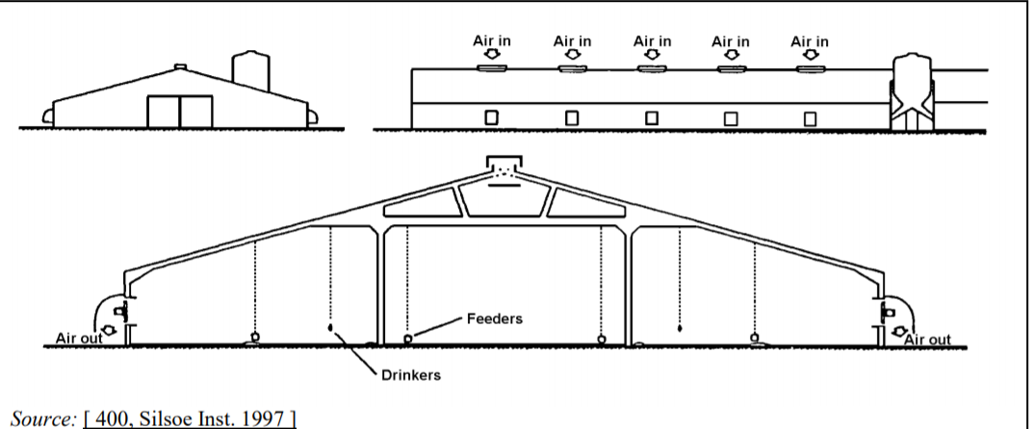
Construction of a Shed
1
Shed Operations
1
Waste storage facility for winter to sell manure in summer months
Insulated walls and ceilings in cold countries
Nipple drinkers are normally used and they must have access to water 24/7 - main worry is ammonia content
Bedding - chopped straw, wood shavings, shredded paper, rice husks - Many types of additives
Replaced at the end of every flock cycle and litter taken
Feeders normally fed on a chain feed conveyor - conveyor speeds changed to vary feed available at one time - Broiler, chain feeders: 0.75 linear metre per 100 birds
Ventilation systems to circulate air throughout the shed
Essential for climate control, drying litter and channelling air to air treatment devices

Slide 12
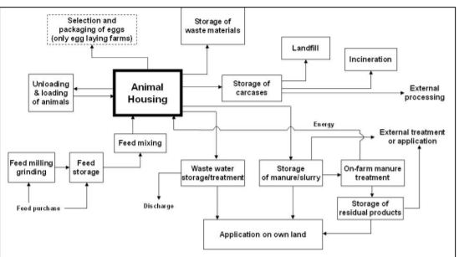

Slide 13
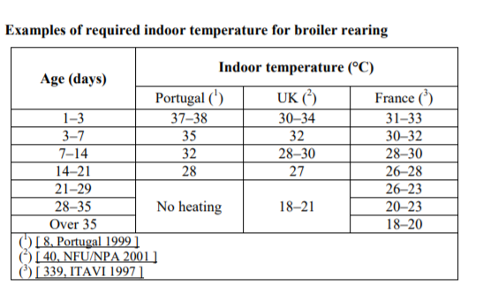
How conditions and behaviour change as birds grow
Temperature reduces as the birds grow as they are bigger so they are better at maintaining temperature
3 Feeding phases -early weeks growing, finishing
Aggression peaks between weeks 2 and 3 then decreases.
Display playful behaviours up to 2 weeks of age

Slide 14
Conditions
Lighting
Rules:
NH3 concentration not exceeding 20 ppm;
CO2 concentration not exceeding 3 000 ppm;
Indoor temperature, when the outside temperature measured in the shade exceeds 30 °C, not exceeding this outside temperature by more than 3 °C;
Indoor average humidity, measured over 48 hours, not exceeding 70% when the outdoor temperature is below 10 °C.
Temperature
Stocking density
Air Quality

Slide 15
Temperature
Effect on behaviour:
Under heat stress - difficulty +open mouth breathing due to more oxygen intake requirements, feed intake reduction to reduce metabolism as this heats up body temperature, reduced activity to cool down, spread wings when lying down.
Increased drinking rate to reduce body temperatures
Heat stress to chicks for the first two weeks results in food reduction of intake by 2.67%
Range of temperature across a range of 22-32 reduced feed intake by 3.6% per 1 degree
Cold temperatures biggest risk is Pant in lower temperatures to control heat and they need dry air to do so.
If your birds cluster away from various parts of the shed, or are hunkered down, that suggests there are cold spots
Too hot, they will move apart or raise their wings. It’s a first sign of ventilation levels not being correct and you need to correct them straight away, or it could be disastrous.”
Too Hot
Open mouth breathing
Feed intake reduction -2.67%
Increased drinking rates
Spread their wings to cool down
Controlling Techniques:
Insulation of the building
Local heating vs space heating
Direct vs indirect heating
Cooling systems like spraying the roof or spraying water mist into shed (fogging)
Wet filters
Heat exchangers
Too Cold
Panting
Increased clustering
Less active
Higher synchronization
Notes:
Causes uneven growth when chicks are first presented to the shed, as they huddle together - if too cold
heat stress damages small intestine wall so damage on feed intake is too big

Slide 16
Lighting
Effect on behaviour:
Increase foraging activities in light hours (scratching pecking)
Study showed that birds reared in 16L:8D photoperiod showed higher flock synchrony - eg sitting and resting behaviours. Flocks under intense lighting showed higher synchrony of preening, eating, rest and foraging behaviours
In general, light intensities of 1-50 lux does not affect BW or feed consumption
Too intense can cause decreased early uniformity, increased incidence of leg disorders, ocular defects (effected sight), increased fearfulness.
Too dim causes larger eye size and retina sizes, increased sign and leg yield as a percentage of live weight, and decreased protein concentration which means increased fat concentration
Bright light is suggested to have higher welfare with more pronounced behavioral rhythms and comfort behaviours
Reduction of intensity during brooding periods
Higher light intensities have shown an increase of bird activity and aggressive behaviour
Effect on behaviour:
Increase foraging activities in light hours (scratching pecking)
Flocks under intense lighting showed higher synchrony of preening, eating, rest and foraging behaviours
Bright light is suggested to have higher welfare with more pronounced behavioral rhythms and comfort behaviours
Reduction of intensity during brooding periods
Higher light intensities have shown an increase of bird activity and aggressive behaviour
Rules:
20 lux that illuminates 80% of the usable area.
From 7 days to - 3 days before slaughter lighting must follow a 24hr rhythm, and includes periods of darkness of 6 hrs total (min 4hr continuous)
Too Bright
Too Dim
Decrease early uniformity
Leg disorders
Oculur defects
General stressed behaviour
Larger eye sizes
Higher fat concentrations vs protein concentration
Increased leg yield

Slide 17
Stocking Densities
Maximum stocking density in the UK is limited to 39kg/m²
High density can impair broiler growth due to worse air quality, increased ammonia production, volatilization and reduced feeder, drinker space resulting in reduced growth rate and worse feed efficiency, increased incidence of disease (due to worse air quality) and poor immunity
Increased cases of contact dematitis and consequent carcass downgrading
More blood glucose levels at higher densities which is an indicator of stress
Densities largely effect bird synchrony due to an increase of socially facilitated behaviours like feeding and preening as they are influenced by the behaviours of surrounding birds
Dispute around apparent worse welfare with high density vs birds natural tendency to gather
Could just be gathering as they are attracted to the same features, ie heaters, feeders or more comfortable areas of the shed
Notes:
17 broilers / m2 showed the best cost benefit - no stress increase and no compromise of BW or feed intake.
Rising temperatures can cause clusters around the outside of the shed as walls can cool them down

Slide 18
Air Quality
Due to changing outdoor conditions it is hard to achieve the right ventilation rate
They are extremely sensitive to air quality because they do not have a diaphragm that allows for easy access for harmful gases and pathogens and they are already vulnerable to big swings in performance.
A properly functioning inlet provides a clean jet of air that follows the ceiling line without falling to the floor in cold weather - most inlets mix outside and inside air temperatures and circulating it at bird height
Most ventilation systems work by calculating the most amount of fresh air required by the flock at max weight then reduce by about 4.7 m3 of air per hour per kilogram of birds
Notes:
(air sacs through their body) (air sacs through their body)

Slide 19
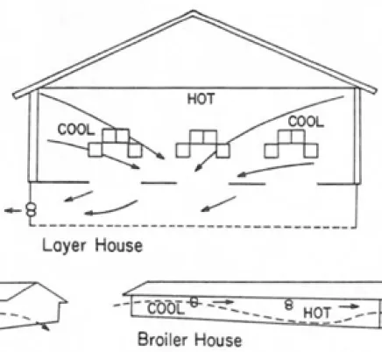
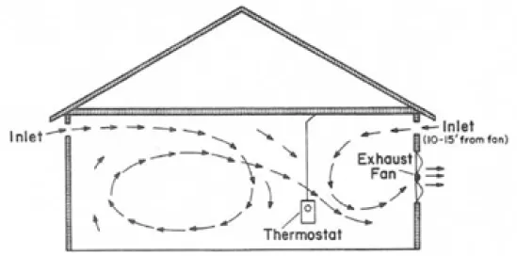
Ventilation
Natural Air Flow System
Mixing of Ventilation Air
Notes:
(air sacs through their body) (air sacs through their body)

Slide 20
Future Plans
Breeds
Market
Disease/ Pathology
Anatomy
Litter Quality
Sustainability

Slide 21
Challenges
Structuring learning - hard to know what i need to learn when you dont know and there's no syllabus
Categorizing behaviours - a lot of overlaps eg locomotives and foraging behaviours
Knowing what information will be useful

Slide 22
Questions

Slide 23
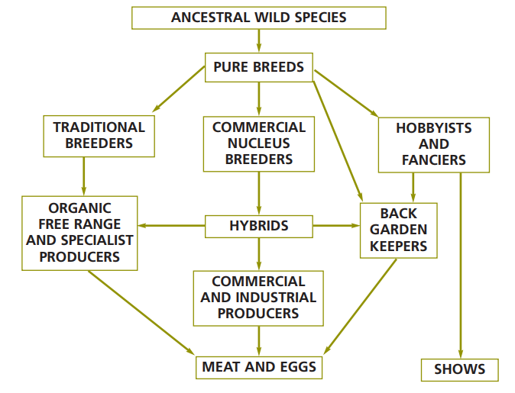
Breeds
Ancestral species is normally fowl
280 breeds of poultry kept in the UK (33 duck, 23 geese, 124 fowls, 63 miniature fowls, 20 true bantam fowls and 18 turkeys)
Have been bred over time for better performance characteristics
Broiler of today is incomparable to one of 40 years ago
Bred to grow so fast that there is an increase of leg and digestive problems
Cobb, Aviagen and Hubbard are the most dominating in broiler breeds all have many breeds
Shift towards slow growing broilers as they demonstrate higher welfare
Ross 308 is the most used broiler according to Aviagen

Slide 24
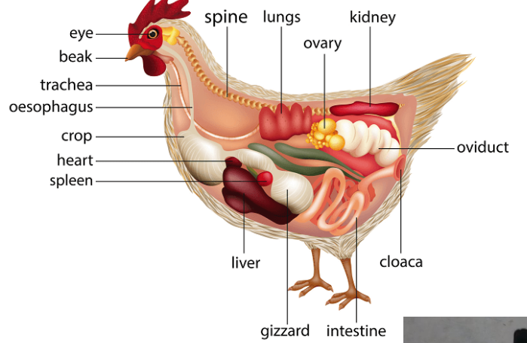
Bird anatomy
All birds excrete from one orifice
Integumentary system - differences are plumage (feathers) and wattle and comb
All to regulate body temperature
Respiratory system no diaphragm and 9 air sacs around the neck
Inhale and dehale by flexing the neck muscles
3 types of bones
Pneumatic - hollow for flying
Medullary - high amount of calcium
Fused bones - fused to vertebrate so bird can be upright
Notes:
https://www.uspoultry.org/educationprograms/pandep_curriculum/documents/pdfs/lesson11/poultryanatomyandphysiologypres.pdf

Slide 25
Enriched spaces
Winter Garden
Number of straw bales
Number of pecking stones
Number of perches
Bales are favoured over perches
Study on enriched spaces
https://www.sciencedirect.com/science/article/pii/S1558787816301915

Slide 26
Locomotive Behaviours
Can be linked to both positive and negative behaviour as there is a lot of commonality between foraging behaviours
Lighting as a positive effect on locomotive behaviours as they are more active in daylight hours
General trend of fewer locomotive behaviours as they grew older and older.
Slower growing broilers show more locomotive behaviour
Environmental enrichment is lined increase in locomotive behaviours and therefore bird weight
Density increases locomotive behaviours.
Head movements is a type of locomotive behaviour as it
Lack of locomotive behaviours cause lameness (lameness can counteract this)

Slide 27
Lying and Resting Behaviours
Differs from sitting as its head is resting on the ground
Largely increases as birds grow older, especially increased after day 6 of the flock. By the time they are 5-6 weeks old they spend at least a quarter of their time asleep.
Largely increased by the influence of other birds in the shed and lighting - when in light for 23hrs they often lose their synchrony and far less sleep as more disturbances
Easily confused with huddling/clustering behaviours as they can rest closer to each other
Largely influenced by lighting timings and group synchronization.
Like resting along walls due to reduced probability of a disturbance
As they grow older they sleep a lot more - quarter of time at end of life
Highly influenced by synchronicity to not disturb other birds, so very susceptible to light
Easily confused with huddling/clustering behaviours as they can rest closer to each other
Largely influenced by lighting timings and group synchronization.
Like resting along walls due to reduced probability of a disturbance

